Slide 1
CODD’s 12 RULES OF RELATIONAL DATABASE

Slide 2
OVERVIEW OF CODD’s RULE
A relational database management system (RDBMS) is a database management system (DBMS) that is based on the relational model as introduced by E. F. Codd.
A short definition of an RDBMS may be a DBMS in which data is stored in the form of tables and the relationship among the data is also stored in the form of tables.
E.F. Codd, the famous mathematician has introduced 12 rules (0-12)for the relational model for databases commonly known as Codd's rules. The rules mainly define what is required for a DBMS for it to be considered relational, i.e., an RDBMS.

Slide 3
Rule 0
This rule states that all subsequent rules are based on the notation that in order for a database to be considered relational, it must use it’s relational facilities exclusively to manage the database.

Slide 4
Rule 1: INFORMATION RULE
All information in the database is to be represented in one and only one way.
All information in an RDB is represented as values in the tables.
This is achieved by values in column and rows of tables.
All information including table names, column names and column data types should be available in same table within the database.
The basic requirement of the relational model.

Slide 5
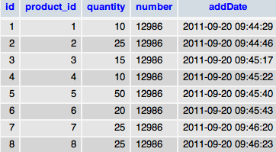

Slide 6
Rule 2: GUARANTEED ACCESS RULE
Each unique piece of data should be accessible by:table name+primary key(row) + attribute(column).
All data are uniquely identified and accessible via this identity.
Most RDBMS do not make the definition of the primary key mandatory and are deficient to that extent .

Slide 7
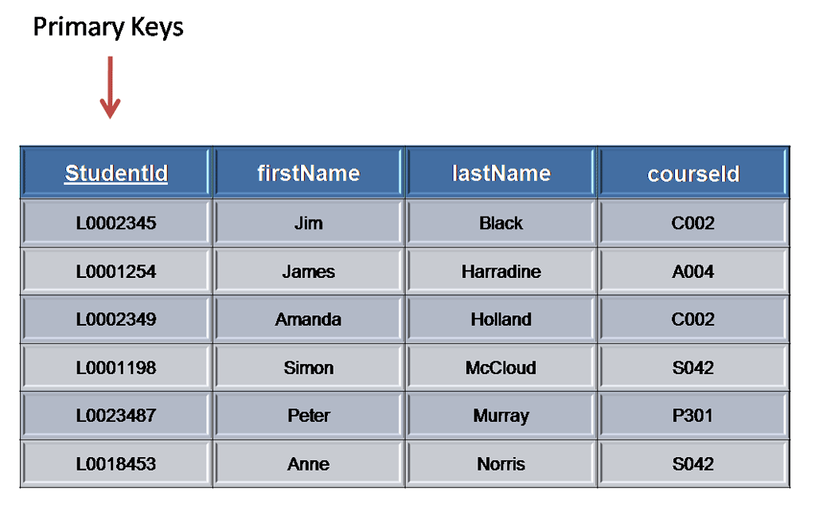

Slide 8
Rule 3 : Systematic treatment of null values
"Null values (distinct from the empty character string or a string of blank characters and distinct from zero or any other number) are supported in fully relational DBMS for representing missing information and inapplicable information in a systematic way, independent of data type."

Slide 9
NULLs may mean: Missing data, Not applicable
Should be handled consistently - Not Zero or Blank
Primary keys — Not NULL
Expressions on NULL should give NULL.
Separate handling of missing and/or non applicable data.
This is distinct to zero or empty strings

Slide 10
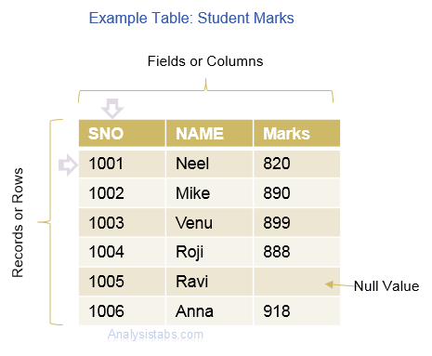

Slide 11
Rule 4:DATABASE DESCRIPTION RULE
The data base description is represented at the logical level in the same way as-ordinary data, so that authorized users can apply the same relational language to its interrogation as they apply to the regular data.
The authorized users can access the database structure by using common language i.e. SQL

Slide 12
Rule 5: COMPREHENSIVE DATA SUBLANGUAGE
A relational system may support several languages and various modes of terminal use .However, there must be at least one language whose statements are expressible, per some well-defined syntax, as character strings and that is comprehensive in supporting all the following items :

Slide 13
Data Definition (create,insert,update)
View Definition
Data Manipulation (alter,delete,truncate)
Integrity Constraints (primary key,foreign key,null values)
Authorization (GRANT , REVOKE)
Transaction boundaries (begin,commit,rollbacketc)
Every RDBMS should provide a language to allow the user to query the contents of the RDBMS and also manipulate the contents of the RDBMS.

Slide 14
Rule 6: VIEW UPDATING RULE
View = ”Virtual table”, temporarily derived from base tables.
Example: If a view is formed as join of 3 tables, changes to view should be reflected in base tables.
Not updatable: View does not have NOT-NULL attribute of base table.
It allow the update of simple theoretically updatable views, but disallow attempts to update complex views.

Slide 15


Slide 16
RULE 7 : HIGH-LEVEL INSERT , UPDATE AND DELETE
This rule states that insert, update, and delete operations should be supported for any retrievable set rather than just for a single row in a single table.
It also perform the operation on multiple row simultaneously .
There must be delete, updating and insertion at the each level of operation. Set operation like union, all union , insertion and minus should also supported.
EXAMPLE:
Suppose if we need to change ID then it will reflect everywhere automatically.

Slide 17


Slide 18
RULE 8 :LOGICAL DATA INDEPENDENCE RULE
What is independence?
The ability to modify schema definition in on level without affecting schema definition in the next higher level is called data independence
The ability to change the logical (conceptual) schema without changing the External schema (User View) is called logical data independence.
EXAMPLE:
The addition or removal of new entities, attributes, or relationships to the conceptual schema should be possible without having to change existing external schemas or having to rewrite existing application programs.

Slide 19
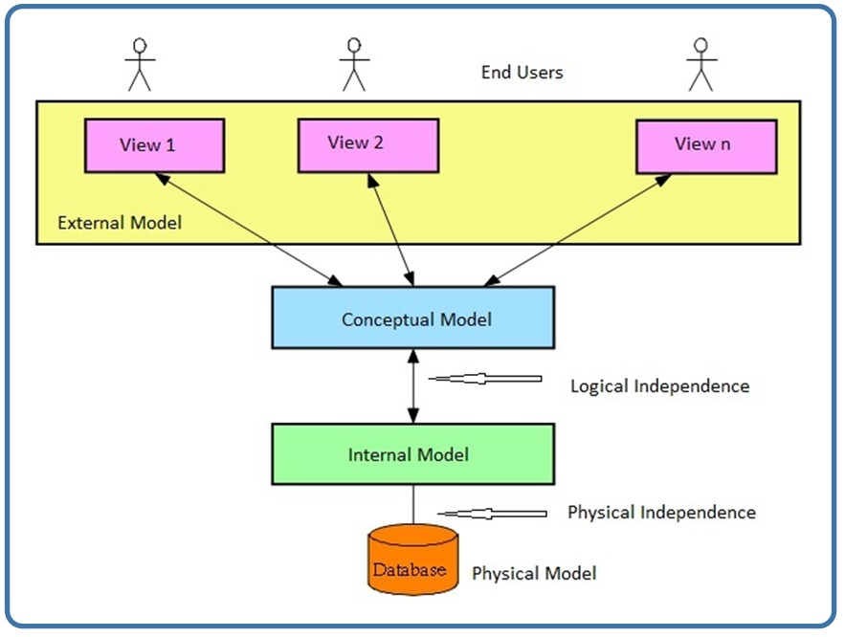

Slide 20


Slide 21
RULE 9:PHYSICAL DATA INDEPENDENCE
The ability to change the physical schema without changing the logical schema is called physical data independence.
This is saying that users shouldn’t be concerned about how the data is stored or how it’s accessed. In fact, users of the data need only be able to get the basic definition of the data they need.
EXAMPLE:
A change to the internal schema, such as using different file organization or storage structures, storage devices, or indexing strategy, should be possible without having to change the conceptual or external schemas.

Slide 22


Slide 23
RULE 10 : INTEGRITY INDEPENDENCE RULE
Data integrity refers to maintaining assuring the accuracy and consistency of data over its entire life cycle.
First insure that correct data type is used.
Check constraints: these allow column value to be checked agenized other column before insertion is allowed.

Slide 24


Slide 25
RULE 11 : DISTRIBUTION INDEPENDECE RULE
“THE RELATION DATA BASE MANAGEMENT HAS DISTRIBUTION INDEPENDENCE”
Distribution independence implies that user should not have to be aware of whether a database is distributed at different sites or not.
Application program and adhoc request are not affected by the change in distribution of physical data. Application program will work even if the programs and data are moved on different site
The RDBMS may spread across the more one system or several networks

Slide 26


Slide 27
RULE 12 : NON-SUBVERSION RULE
There should be no way to modify to database structure other then through the multiple row data base language(SQL).
Example:
A relational system has a low-level (single-record-at-a-time) language, that low level cannot be used to subvert or bypass the integrity Rules and constraints expressed in the higher level relational language (multiple-records-at-a-time).”

Slide 28
Functional Dependencies
Constraints on the set of legal relations.
Require that the value for a certain set of attributes determines uniquely the value for another set of attributes.
A functional dependency is a generalization of the notion of a key.

Slide 29
Functional Dependencies (Cont.)
Let R be a relation schema
α ⊆ R and β ⊆ R
The functional dependency
α → β
holds on R if and only if for any legal relations r(R), whenever any two tuples t₁ and t₂ of r agree on the attributes α, they also agree on the attributes β. That is,
t₁[α] = t₂ [α] ⇒ t₁[β ] = t₂ [β ]
Example: Consider r(A,B ) with the following instance of r.
On this instance, A → B does NOT hold, but B → A does hold.
4
1 5
3 7

Slide 30
Functional Dependencies (Cont.)
K is a superkey for relation schema R if and only if K → R
K is a candidate key for R if and only if
  K → R, and
  for no α ⊂ K, α → R
Functional dependencies allow us to express constraints that cannot be expressed using superkeys. Consider the schema:
bor_loan = (customer_id, loan_number, amount ).
We expect this functional dependency to hold:
loan_number → amount
but would not expect the following to hold:
amount → customer_name

Slide 31
Use of Functional Dependencies
We use functional dependencies to:
  test relations to see if they are legal under a given set of functional dependencies.
    If a relation r is legal under a set F of functional dependencies, we say that r satisfies F.
  specify constraints on the set of legal relations
    We say that F holds on R if all legal relations on R satisfy the set of functional dependencies F.
Note: A specific instance of a relation schema may satisfy a functional dependency even if the functional dependency does not hold on all legal instances.
  For example, a specific instance of loan may, by chance, satisfy
  amount → customer_name.

Slide 32
Functional Dependencies (Cont.)
A functional dependency is trivial if it is satisfied by all instances of a relation
  Example:
    customer_name, loan_number → customer_name
    customer_name → customer_name
  In general, α → β is trivial if β ⊆ α

Slide 33
Closure of a Set of Functional Dependencies
Given a set F of functional dependencies, there are certain other functional dependencies that are logically implied by F.
  For example: If A → B and B → C, then we can infer that A → C
The set of all functional dependencies logically implied by F is the closure of F.
We denote the closure of F by F⁺.
F⁺ is a superset of F.

Slide 34
Closure of a Set of Functional Dependencies
Given a set F set of functional dependencies, there are certain other functional dependencies that are logically implied by F.
  For example: If A → B and B → C, then we can infer that A → C
The set of all functional dependencies logically implied by F is the closure of F.
We denote the closure of F by F⁺.
We can find all of F⁺ by applying Armstrong’s Axioms:
  if β ⊆ α, then α → β (reflexivity)
  if α → β, then γ α → γ β (augmentation)
  if α → β, and β → γ, then α → γ (transitivity)
These rules are
  sound (generate only functional dependencies that actually hold) and
  complete (generate all functional dependencies that hold).

Slide 35
Example
R = (A, B, C, G, H, I)
F = { A → B
A → C
CG → H
CG → I
B → H}
some members of F⁺
  A → H
    by transitivity from A → B and B → H
  AG → I
    by augmenting A → C with G, to get AG → CG
    and then transitivity with CG → I
  CG → HI
    by augmenting CG → I to infer CG → CGI,
    and augmenting of CG → H to infer CGI → HI,
    and then transitivity

Slide 36
Procedure for Computing F⁺
To compute the closure of a set of functional dependencies F:
F ⁺ = F
repeat
for each functional dependency f in F⁺
apply reflexivity and augmentation rules on f
add the resulting functional dependencies to F ⁺
for each pair of functional dependencies f₁and f₂ in F ⁺
if f₁ and f₂ can be combined using transitivity
then add the resulting functional dependency to F ⁺
until F ⁺ does not change any further
NOTE: We shall see an alternative procedure for this task later

Slide 37
Closure of Functional Dependencies (Cont.)
We can further simplify manual computation of F⁺ by using the following additional rules.
  If α → β holds and α → γ holds, then α → β γ holds (union)
  If α → β γ holds, then α → β holds and α → γ holds (decomposition)
  If α → β holds and γ β → δ holds, then α γ → δ holds (pseudotransitivity)
  The above rules can be inferred from Armstrong’s axioms.

Slide 38
Closure of Attribute Sets
Given a set of attributes α, define the closure of α under F (denoted by α⁺) as the set of attributes that are functionally determined by α under F
Algorithm to compute α⁺, the closure of α under F
result := α;
while (changes to result) do
for each β → γ in F do
begin
if β ⊆ result then result := result ∪ γ
end

Slide 39
Example of Attribute Set Closure
R = (A, B, C, G, H, I)
F = {A → B
A → C
CG → H
CG → I
B → H}
(AG)⁺
  1. result = AG
  2. result = ABCG (A → C and A → B)
  3. result = ABCGH (CG → H and CG ⊆ AGBC)
  4. result = ABCGHI (CG → I and CG ⊆ AGBCH)
Is AG a candidate key?
  Is AG a super key?
    Does AG → R? == Is (AG)⁺ ⊇ R
  Is any subset of AG a superkey?
    Does A → R? == Is (A)⁺ ⊇ R
    Does G → R? == Is (G)⁺ ⊇ R

Slide 40
Uses of Attribute Closure
There are several uses of the attribute closure algorithm:
Testing for superkey:
  To test if α is a superkey, we compute α^{+,} and check if α⁺ contains all attributes of R.
Testing functional dependencies
  To check if a functional dependency α → β holds (or, in other words, is in F⁺), just check if β ⊆ α⁺.
  That is, we compute α⁺ by using attribute closure, and then check if it contains β.
  Is a simple and cheap test, and very useful
Computing closure of F
  For each γ ⊆ R, we find the closure γ⁺, and for each S ⊆ γ⁺, we output a functional dependency γ → S.

Slide 41
Canonical Cover
Sets of functional dependencies may have redundant dependencies that can be inferred from the others
  For example: A → C is redundant in: {A → B, B → C}
  Parts of a functional dependency may be redundant
    E.g.: on RHS: {A → B, B → C, A → CD} can be simplified to
    {A → B, B → C, A → D}
    E.g.: on LHS: {A → B, B → C, AC → D} can be simplified to
    {A → B, B → C, A → D}
Intuitively, a canonical cover of F is a “minimal” set of functional dependencies equivalent to F, having no redundant dependencies or redundant parts of dependencies

Slide 42
Extraneous Attributes
Consider a set F of functional dependencies and the functional dependency α → β in F.
  Attribute A is extraneous in α if A ∈ α
  and F logically implies (F – {α → β}) ∪ {(α – A) → β}.
  Attribute A is extraneous in β if A ∈ β
  and the set of functional dependencies
  (F – {α → β}) ∪ {α →(β – A)} logically implies F.
Note: implication in the opposite direction is trivial in each of the cases above, since a “stronger” functional dependency always implies a weaker one
Example: Given F = {A → C, AB → C }
  B is extraneous in AB → C because {A → C, AB → C} logically implies A → C (I.e. the result of dropping B from AB → C).
Example: Given F = {A → C, AB → CD}
  C is extraneous in AB → CD since AB → C can be inferred even after deleting C

Slide 43
Testing if an Attribute is Extraneous
Consider a set F of functional dependencies and the functional dependency α → β in F.
To test if attribute A ∈ α is extraneous in α
  compute ({α} – A)⁺ using the dependencies in F
  check that ({α} – A)⁺ contains β; if it does, A is extraneous in α
To test if attribute A ∈ β is extraneous in β
  compute α⁺ using only the dependencies in
  F’ = (F – {α → β}) ∪ {α →(β – A)},
  check that α⁺ contains A; if it does, A is extraneous in β

Slide 44
Canonical Cover
A canonical cover for F is a set of dependencies F_{c} such that
  F logically implies all dependencies in F_{c,} and
  F_{c} logically implies all dependencies in F, and
  No functional dependency in F_{c} contains an extraneous attribute, and
  Each left side of functional dependency in F_{c} is unique.
To compute a canonical cover for F:
repeat
Use the union rule to replace any dependencies in F
α₁ → β₁ and α₁ → β₂ with α₁ → β₁ β₂
Find a functional dependency α → β with an
extraneous attribute either in α or in β
If an extraneous attribute is found, delete it from α → β
until F does not change
Note: Union rule may become applicable after some extraneous attributes have been deleted, so it has to be re-applied

Slide 45
Computing a Canonical Cover
R = (A, B, C)
F = {A → BC
B → C
A → B
AB → C}
Combine A → BC and A → B into A → BC
  Set is now {A → BC, B → C, AB → C}
A is extraneous in AB → C
  Check if the result of deleting A from AB → C is implied by the other dependencies
    Yes: in fact, B → C is already present!
  Set is now {A → BC, B → C}
C is extraneous in A → BC
  Check if A → C is logically implied by A → B and the other dependencies
    Yes: using transitivity on A → B and B → C.
      Can use attribute closure of A in more complex cases
The canonical cover is: A → B
B → C

